Slide 1
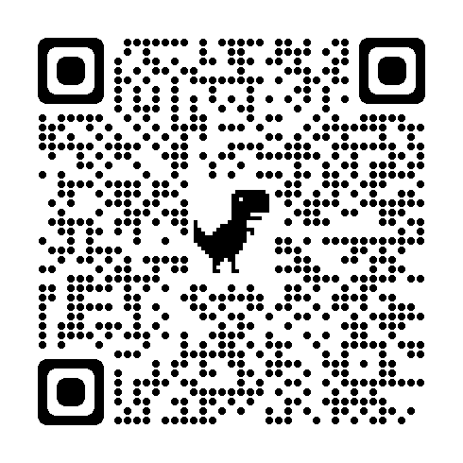
https://health.mo.gov/living/healthcondiseases/chronic/asthma/pdf/asthmastateplan.pdf

Slide 2
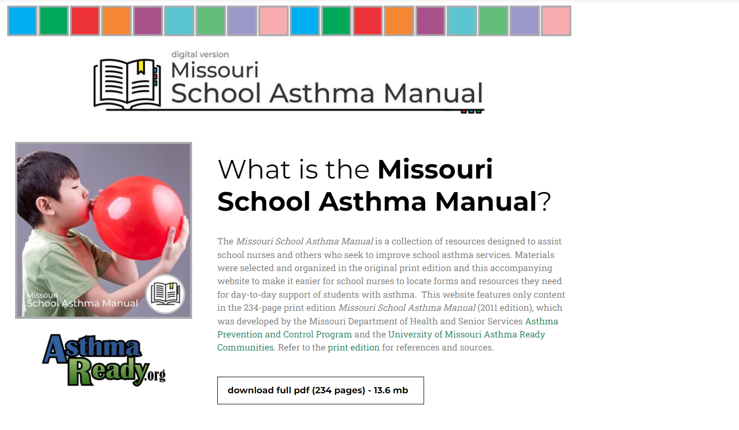
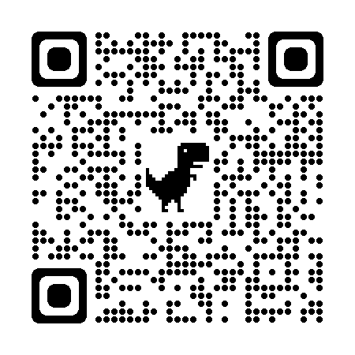
http://www.schoolasthmamanual.com/

Slide 3
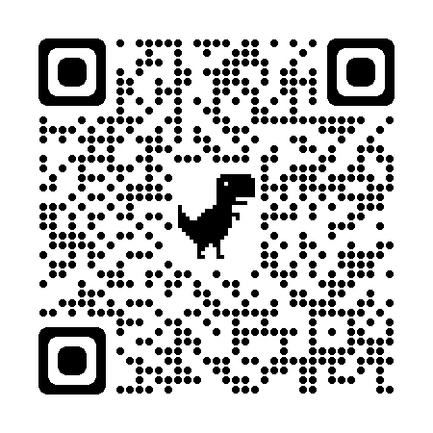
http://www.schoolnurselink.com/

Slide 4
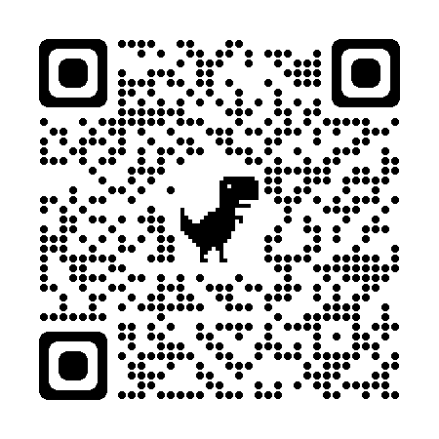
www.asthmabridge.com

Slide 5
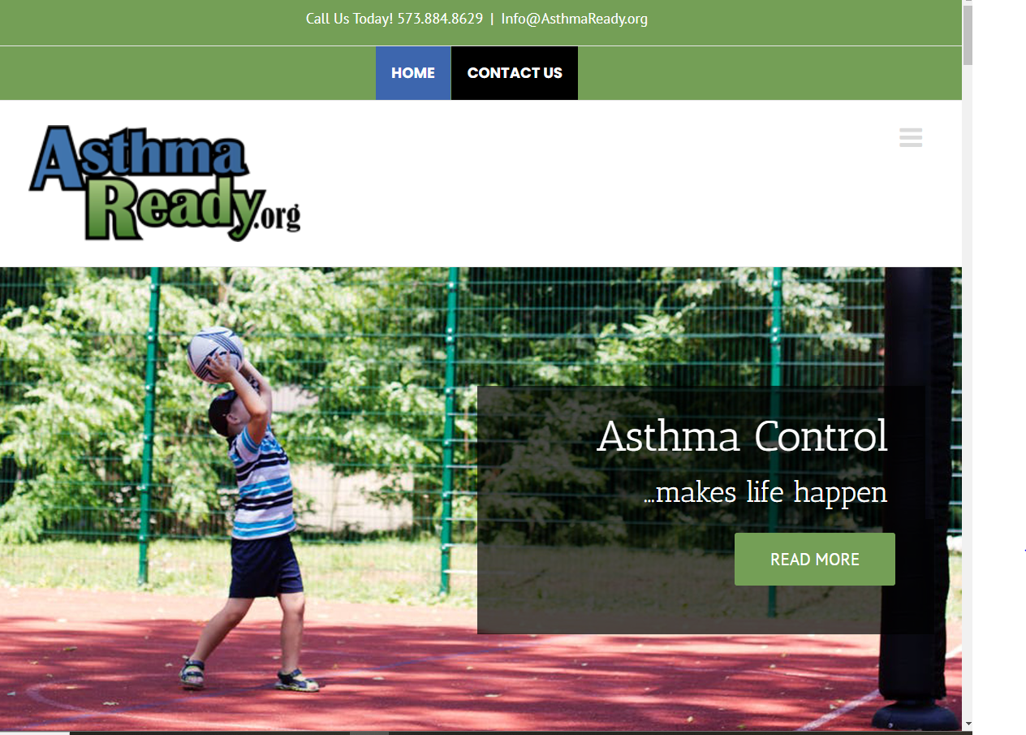
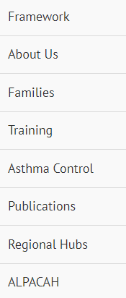
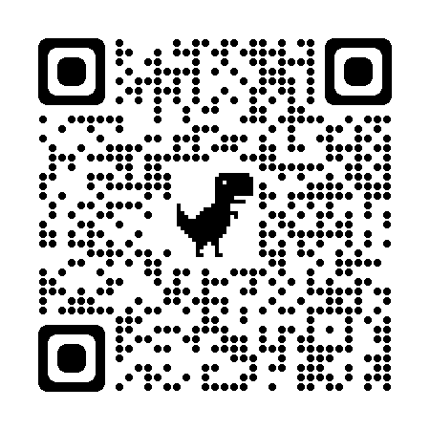
https://asthmaready.org/
https://asthmaready.org/

Slide 6
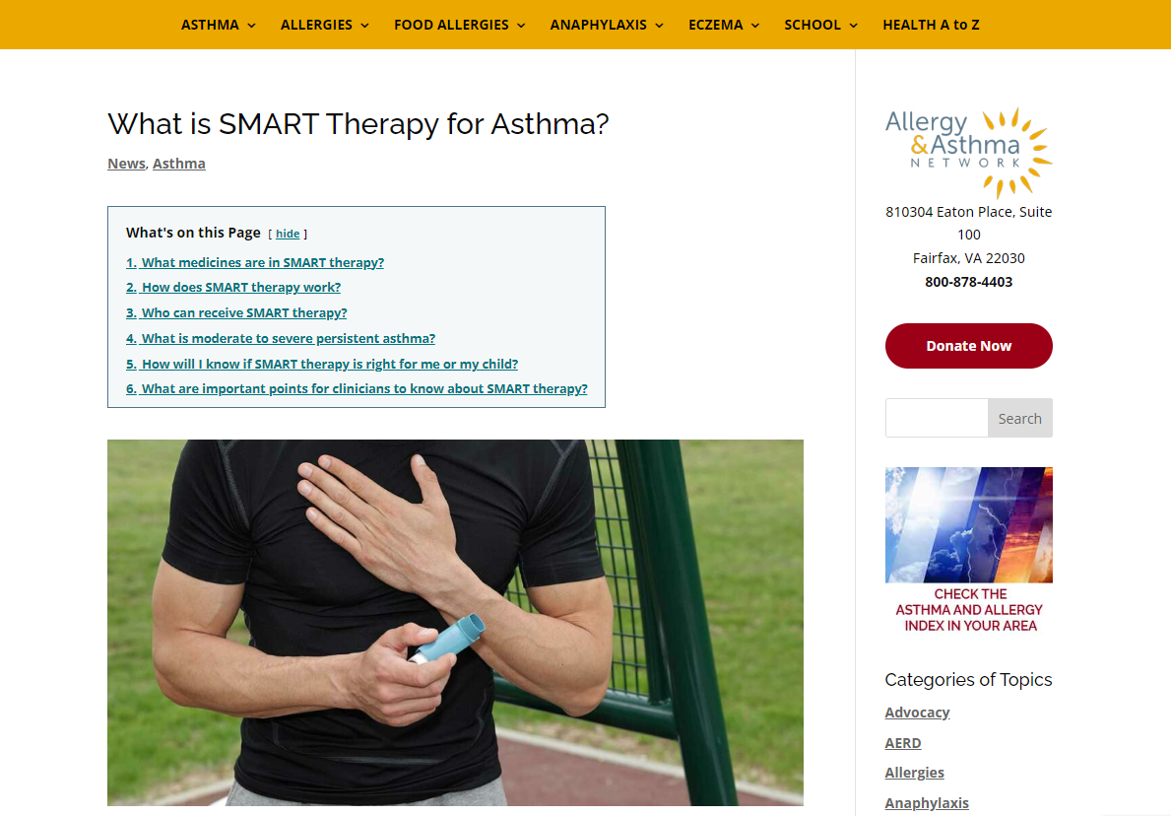
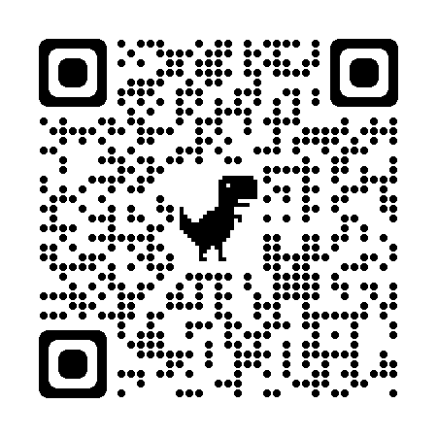
https://allergyasthmanetwork.org/news/asthma-smart-therapy/

Slide 7
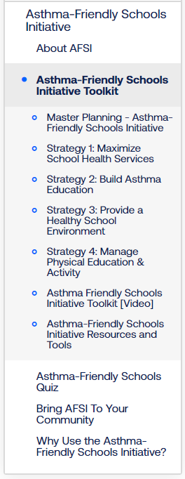
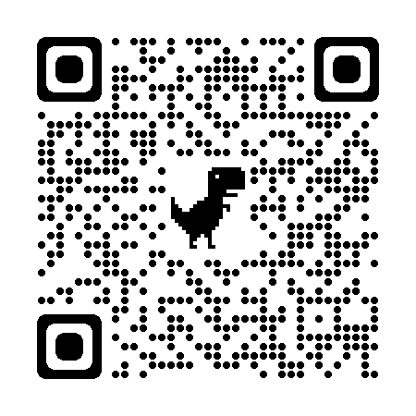
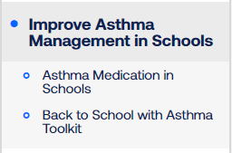
https://www.lung.org/

Slide 8
Peggy Gaddy, RRT, MBA
Missouri Asthma Prevention and Control Program Manager
Peggy.gaddy@health.mo.gov
573-522-2876

